Slide 1
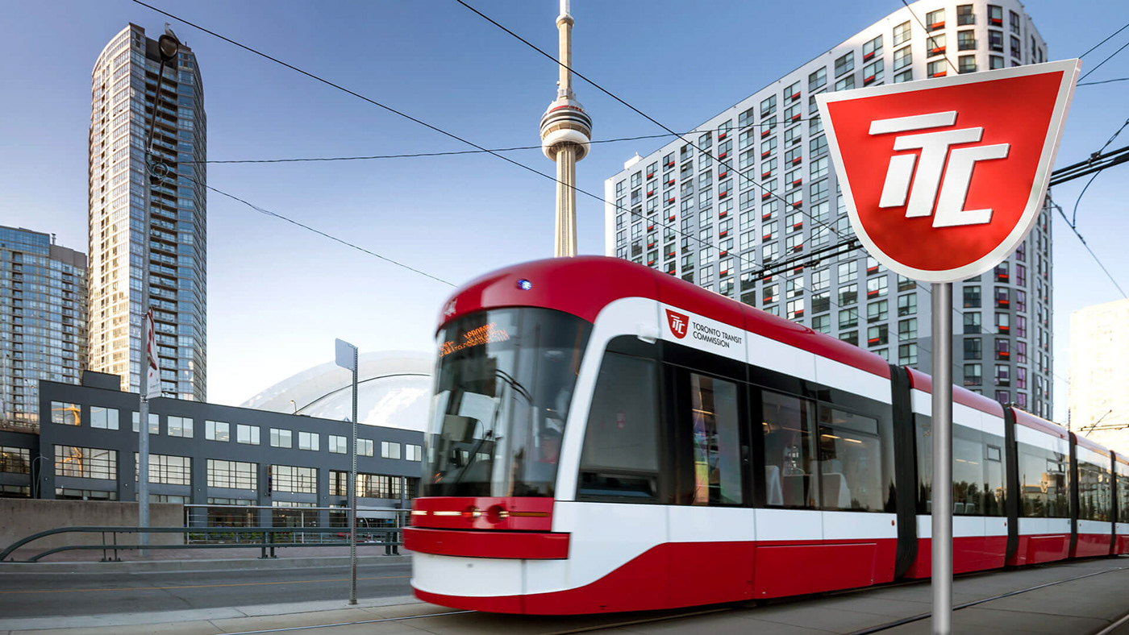
MIA5130 Course Project TTC Line 1 Delay Reduction & Scheduling Optimization Using Risk-Aware Forecasting & MILP
UNIVERSITY OF OTTAWA
DANIEL S. DEMOZ
LINDSAY BERTRAND
TOMAS BURKE
NEETISH RAMPERSAD

Slide 2



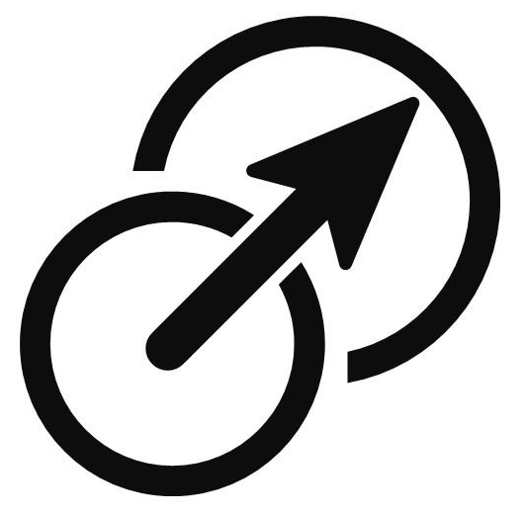
Project Goal & Objectives
Goal:
Develop a data-driven, risk-aware scheduling model to reduce delays and optimize operations on Toronto’s Line 1 Subway.
Key Objectives
Forecast hourly disruption risk using historical delay data
Optimize train frequency using MILP based on forecasted risk
Minimize costs while meeting service quality targets
Build a scalable framework adaptable to other TTC lines

Slide 3
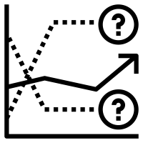


Module Overview & Interaction
Module | 1. Forecasting | 2. Train Scheduling | 3. Train Deployment (Operation)
Overview | Purpose: Uses historical delay data and Facebook Prophet to predict hourly delay risk levels. Output: A risk score for each hour indicating the probability and severity of delays. | Purpose: Uses the forecasted risk to determine optimal train frequencies. Method: Employs MILP optimization to balance reducing delays with operational costs. Output: An hourly train schedule specifying how many trains to run each hour. | Purpose: Implements the scheduled train frequencies in real-time ops. Function: Dispatches trains according to the schedule. Feedback: Can provide real-time data on actual delays or incidents, which can be fed back into the forecasting module.
How they Interact | The Forecasting Module predicts delay risks for upcoming hours. This informs the Train Scheduling Module, which adjusts train frequencies to proactively mitigate delays. The optimized schedule is then executed in the Train Deployment Module, which dispatches trains accordingly. Real-world deployment data (like actual delays or incidents) can be fed back to refine future forecasts, creating a closed-loop system for continuous improvement.

Slide 4




Forecasting Delay Risk
Risk peaks align with high ridership hours – used to trigger schedule adjustments.
Hour | Trains / Hr (TPH) | Avg Delay (min) | Risk
6 | 30 | 3.5 | 176.3
7 | 30 | 3.5 | 230.4
8 | 35 | 3 | 293.6
9 | 30 | 3.5 | 234.8
10 | 30 | 3.5 | 226
11 | 35 | 3 | 251.4
12 | 35 | 3 | 299.1
13 | 35 | 3 | 285.2
14 | 35 | 3 | 304.4
15 | 35 | 3 | 287.1
16 | 35 | 3 | 358.7
17 | 35 | 3 | 393.6
18 | 35 | 3 | 334.5
19 | 35 | 3 | 306.5
20 | 35 | 3 | 272.2
21 | 30 | 3.5 | 223.9
22 | 35 | 3 | 272
23 | 35 | 3 | 351.3
Objective Value: 5457
Method
Time Series Model: Facebook Prophet Input: 2024 TTC passenger-related delays (top 5 codes) Preprocessing: log-transform → model → inverse-transform for interpretability
Performance
MAE: 3.6 minutes RMSE: 7.88 minutes
Thresholds
Risk > 250 triggers high-risk classification → used in MILP to boost train frequency
Trade-off
Simply, fast modeling vs fine-grained accuracy

Slide 5


Optimization with MILP
Striking the balance between efficiency and reliability.
Risk Forecast
MILP Model
Hourly Freq. Schedule
Method
MILP built in Python using PuLP Objective: balance risk mitigation and cost efficiency
Constraints
Max train hours based on available fleet Soft cap at 30 trains / hour when risk < 250
Output
Dynamic train frequencies that adjust to forecasted risk Prioritizes high-risk hours with higher frequencies
Trade-off
Higher frequency = less delay but more cost Lower frequency = cost savings, risk of overcrowding
Constraints
Component | Value / Description
Fleet Size | 65 trains
Frequency Range | 23-35 trains / hour
Capacity per Train | 1,080 passengers
Cost per Train-Hour | $265
Delay Target | ≤ 3 minutes (average)

Slide 6
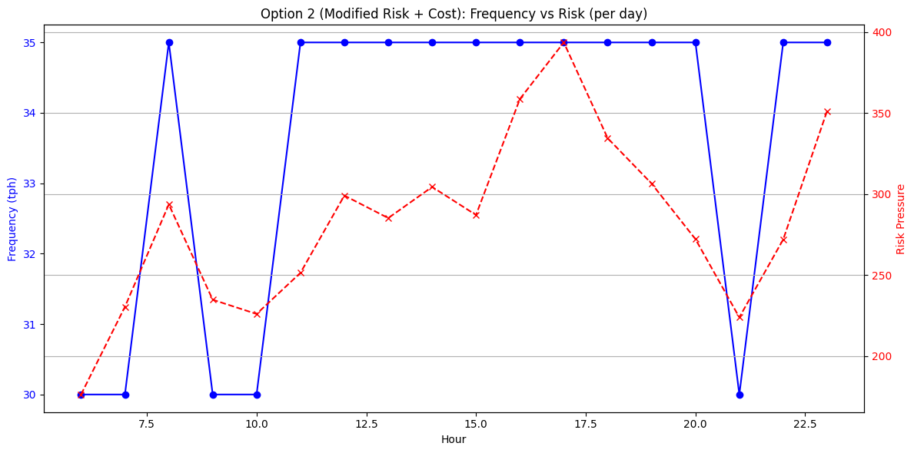
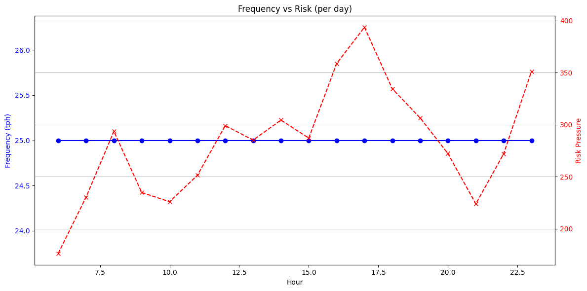
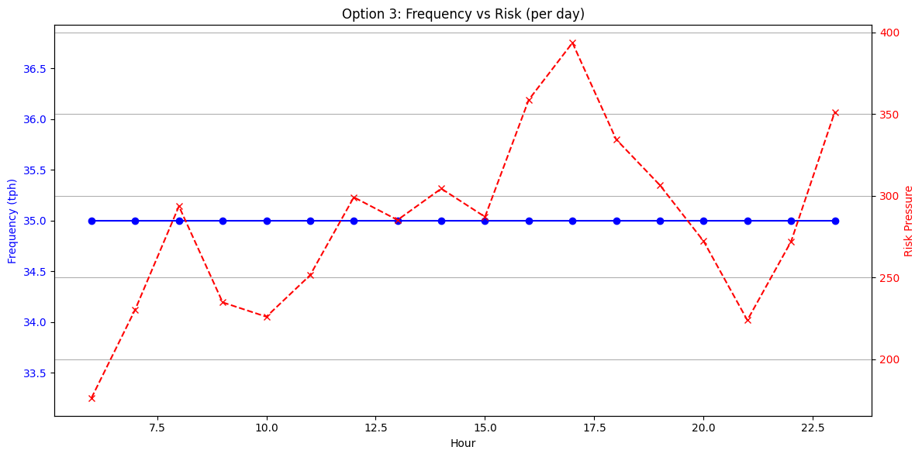
Optimization Results
Frequency

Slide 7
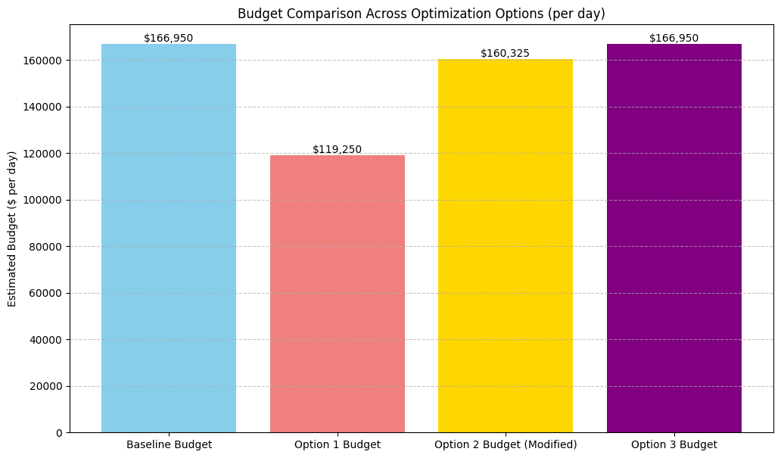
Optimization Results
Budget
Metric | Baseline | Option 1 (Min Frequency) | Option 2 (Modified Risk + Cost) | Option 3 (Max Min Frequency)
Total Service Hours | 630.00 | 450.00 | 605.00 | 630.00
Estimated Budget ($) | 166,950.00 | 119,250.00 | 160,325.00 | 166,950.00
Estimated Budget Saved ($) | 0.00 | 47,700.00 | 6,625.00 | 0.00
Average Estimated Delay (min) | 3.00 | 4.20 | 3.14 | 3.00
Maximum Estimated Delay (min) | 3.00 | 4.20 | 3.50 | 3.00

Slide 8

System Integration & Trade-Offs
System-wide performance depends on how well modules interact with each other.
Schedule outcomes inform future forecasts
Forecasting Module
Hourly Risk Scores
Key Trade-offs
Reliability vs Cost: higher frequency improves delay performance, but increases operating costs Dynamic vs Static: dynamic scheduling adapts to risk but requires real-time or predictive inputs Flexibility vs Feasibility: inventory constraints cap optimization potential
Deployment Module MILP Optimization
Train Schedules
Scheduling Module Fleet, Cost, Capacity Constraints

Slide 9



Evaluation, Lessons, and Limitations
Every decision support system has a blind spot – knowing it is step one.
What Worked | Insights Gained | Limitations
Forecast-informed scheduling significantly improved performance MILP was effective for managing complex constraints Modular design makes the system scalable and interpretable | Forecast accuracy is critical to avoid over/under-scheduling Even simple risk thresholds yield significant improvements Integrating forecasting and optimization outperforms static methods | No real-time data or model retraining Assumes stationary rider behavior across days / seasons Fixed operating costs – no variation by time of day or energy use Ignores downstream effects (e.g. downstream spillover)

Slide 10


Future System Enhancements
Add real-time risk scoring using IoT sensors or cameras
Integrate seasonality and weather data into forecasting
Use ensemble models or real-time Prophet updates
System Scaling & Feedback Loops
Extend model to other TTC lines or modes (e.g., streetcars)
Introduce feedback loop from delivery performance → forecasting
Incorporate staffing schedules into the optimization
Model Improvements
Long-Term Enhancements
The foundation is laid – next steps are smarter, faster, and city-wide.

